Slide 1
Venn Diagram
A Venn diagram is a visual tool often used to illustrate the relationships between different sets, and it can be applied to logic gates as well. In the context of logic gates, a Venn diagram helps visualize how different logical operations correspond to different regions of the diagram.
Using Venn diagrams with logic gates helps to visually understand and analyze the behavior of different logical operations. It's a great way to see the relationships and interactions between different variables.

Slide 2
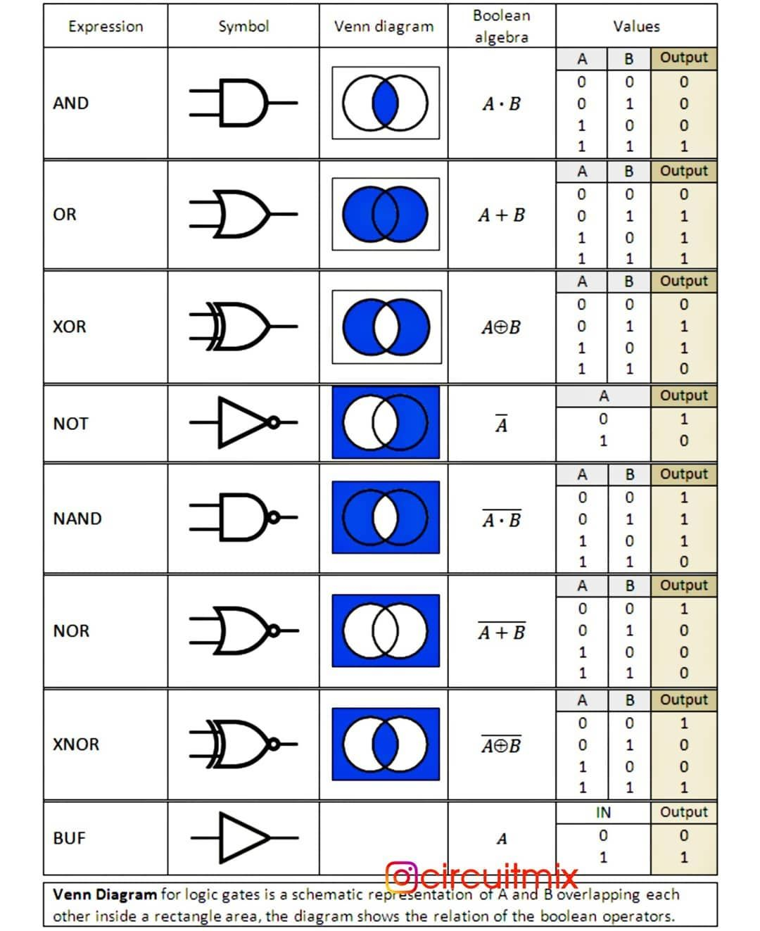

Slide 3
Any logic expression may be expressed in two standard forms:
Sum-of-products (SOP)
eg: F(A,B,C)=ABC+AB’C’
Product-of-sums (POS)
eg: F(A,B,C)=(A+B+C).(A+B’+C’)

Slide 4
Sum-of-products (SOP)
When two or more product terms (or ANDed terms ) are summed by Boolean algebra, the resulting expression is sum-of-products.
eg F=AB’+AB’C’
F=ABC+C’D+BCD’
SOP expression is two or more AND functions ORed together.
SOP form can also contain a term with a single variable such as A +AB +B C.
In SOP representation, 0 represents A’ and 1 represents A. Only 1s output is taken.

Slide 5
AB’+B’C+AD is not standard SOP.
AB’CD +ABCD + ABC’D is standard SOP.
Each individual product term in standard SOP form is called as "minterm" and is represented by 'm'. Standardization makes the evaluation, simplification, implementation, realization of Boolean expression much more systematic and easier.

Slide 6
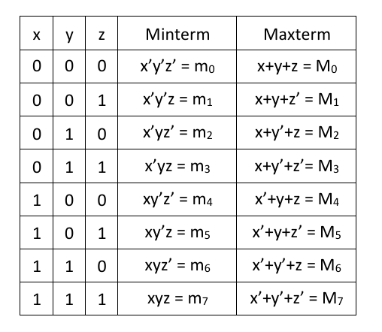

Slide 7
Product of sums (POS)
When two or more sum terms are multiplied, the resulting expression is product of sum.
E.g., (A’+B)(A+B’+C’)(A’+B+C)
In terms of logic function, it is the AND function of two or more ORed functions.
In POS. representation, 0 represents A and 1 represents A’ and only O's output is taken.
A POS expression can also contain a single variable terms. E.g., A .(B’+C’).(B+C)

Slide 8
Standard POS
Standard POS is one in which all the variables in the domain appear in each sum term in the expression.
A(B’+C)(B + C) is not standard POS
(A+B+C’)(A+B’+C’)is standard POS
Each individual sum term in standard POS form is called "maxterm“ and is represented by ‘M'.

Slide 9
Converting SOP to standard SOP
Multiply each product term by (A + A) where A is the missing term.
Expand the multiplication and repeat step 1 until standard SOP is obtained.

Slide 10
Converting POS to standard POS
Add A. A’ to each sum term, where A is missing term.
Apply rule A+BC=(A+B)(A+C)
A.A=A
Repeat step 1 to 3 until standard POS is obtained.

Slide 11
Relationship between minterms and maxterms
E.g., A’B’C’=(A+B+C)’ [De-Morgan's law ]
i.e., Each maxterm is the complement of its minterm & viceversa.

Slide 12
Conversion of standard SOP to POS
Evaluate each SOP terms and determine its binary representation.
Determine all the binary number not included in evaluation in step 1.
Write equivalent sum term for each binary number obtained in step 2.
(Note: The similar process is applied for POS to SOP.)

